Slide 1
Monday

Slide 2
Course Logistics
Problem Set 1 – Due Wednesday, February 8
Weekly Activity – Jupyter Notebook uploaded – submission process TODO
Project Milestone 1 – Due Wednesday, Feb. 1

Slide 3
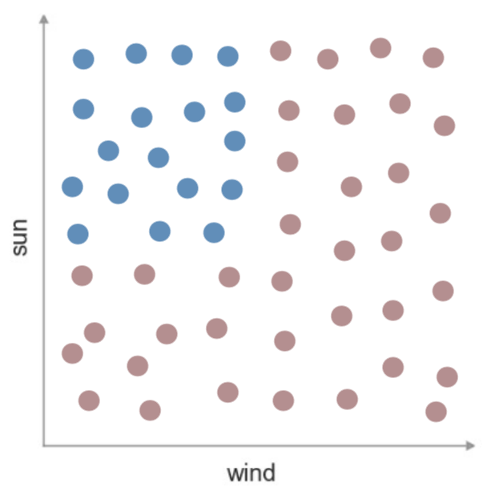
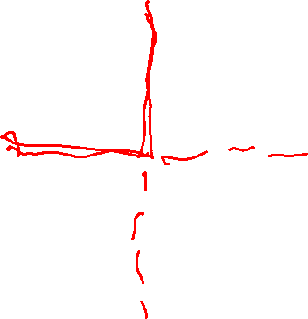
Machine Decision Making - Tennis
Consider this visualization of my data
And our model of a predictor
What would the decision boundary look
like here?

Slide 4
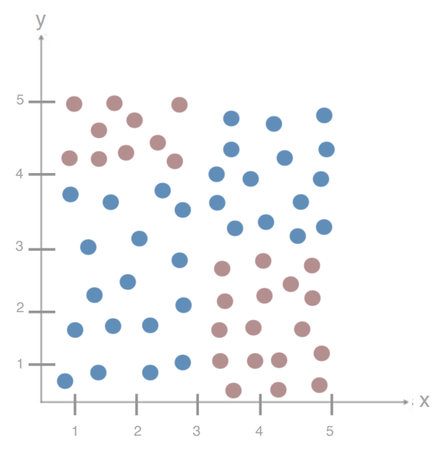
Decision Trees – Adding Complexity
How do we decide the order of our splits?
How do we decide the location of splits?
With continuous variables?
How do we know we’re done?

Slide 5
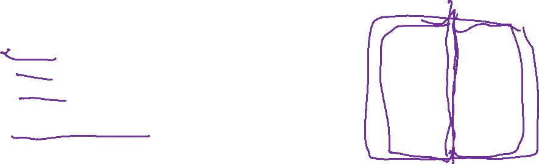
Decision Trees – Minimizing Entropy
We are creating a split to minimize the entropy of our set…
But really, we’re creating two sets, each with their own entropy, but a smaller number of samples in each.
D_{par} = Data found in Parent Node
D_{left} = Data found in Left Node
D_{right} = Data found in Right Node
I() = Impurity function (entropy)
x_{i} = feature for split

Slide 6
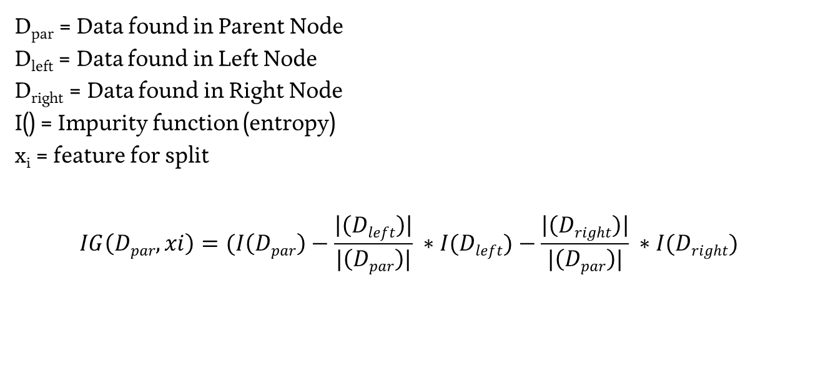
Decision Trees – Information Gain
D_{par} = Data found in Parent Node
D_{left} = Data found in Left Node
D_{right} = Data found in Right Node
I() = Impurity function (entropy)
x_{i} = feature for split
$$IG\left(Dpar,xi\right)=(I\left(Dpar\right)−\frac{\left|\left(Dleft\right)\right|}{|\left(Dpar\right)|} ∗I(Dleft)−\frac{\left|\left(Dright\right)\right|}{|\left(Dpar\right)|} ∗I(Dright)$$

Slide 7

Decision Trees – Choosing a Split
$$IG\left(Dpar,xi\right)=I\left(Dpar\right)−\frac{\left|\left(Dleft\right)\right|}{\left|\left(Dpar\right)\right|} ∗I(Dleft)−\frac{\left|\left(Dright\right)\right|}{\left|\left(Dpar\right)\right|} ∗I(Dright)$$
Split based on the feature x_{i} with the highest Information Gain!

Slide 8

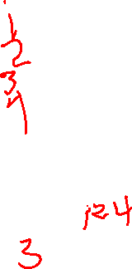

Decision Trees – Splitting Cancer
$$IG\left(Dpar,TA\right)=(I\left(Dpar\right)−\frac{\left|\left(Dleft\right)\right|}{\left|\left(Dpar\right)\right|} ∗I(Dleft)−\frac{\left|\left(Dright\right)\right|}{\left|\left(Dpar\right)\right|} ∗I(Dright)$$
D_{par} = | D_{par} | = I(D_{par}) =
D_{left} = | D_{left} | = I(D_{left}) =
D_{right} = | D_{right} | = I(D_{right}) =
Test A | Test B | Test C | Cancer?
Pos | Neg | Neg | No
Pos | Pos | Neg | No
Neg | Pos | Pos | Yes
Pos | Neg | Pos | Yes

Slide 9
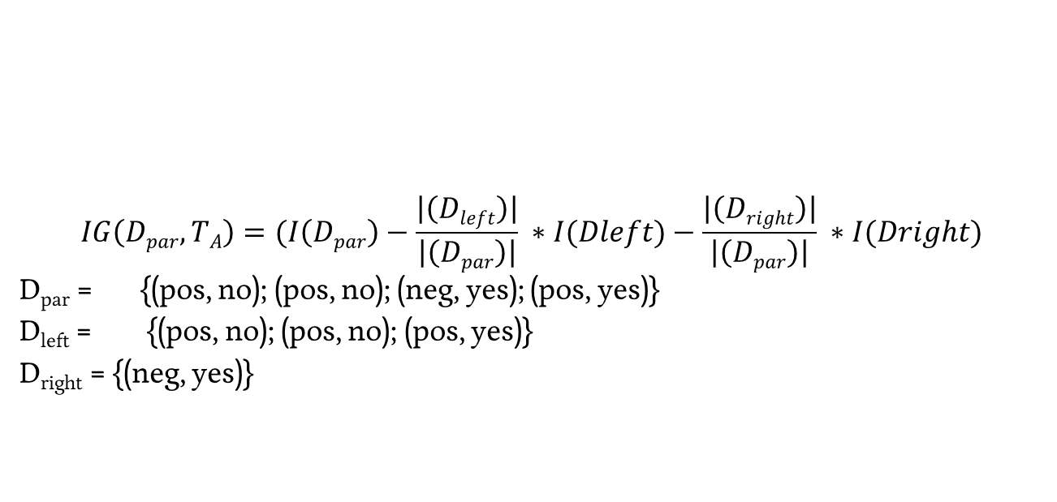

Decision Trees – Splitting Cancer
$$IG\left(Dpar,TA\right)=(I\left(Dpar\right)−\frac{\left|\left(Dleft\right)\right|}{\left|\left(Dpar\right)\right|} ∗I(Dleft)−\frac{\left|\left(Dright\right)\right|}{\left|\left(Dpar\right)\right|} ∗I(Dright)$$
D_{par} = {(pos, no); (pos, no); (neg, yes); (pos, yes)}
D_{left} = {(pos, no); (pos, no); (pos, yes)}
D_{right} = {(neg, yes)}
Test A | Test B | Test C | Cancer?
Pos | Neg | Neg | No
Pos | Pos | Neg | No
Neg | Pos | Pos | Yes
Pos | Neg | Pos | Yes

Slide 10
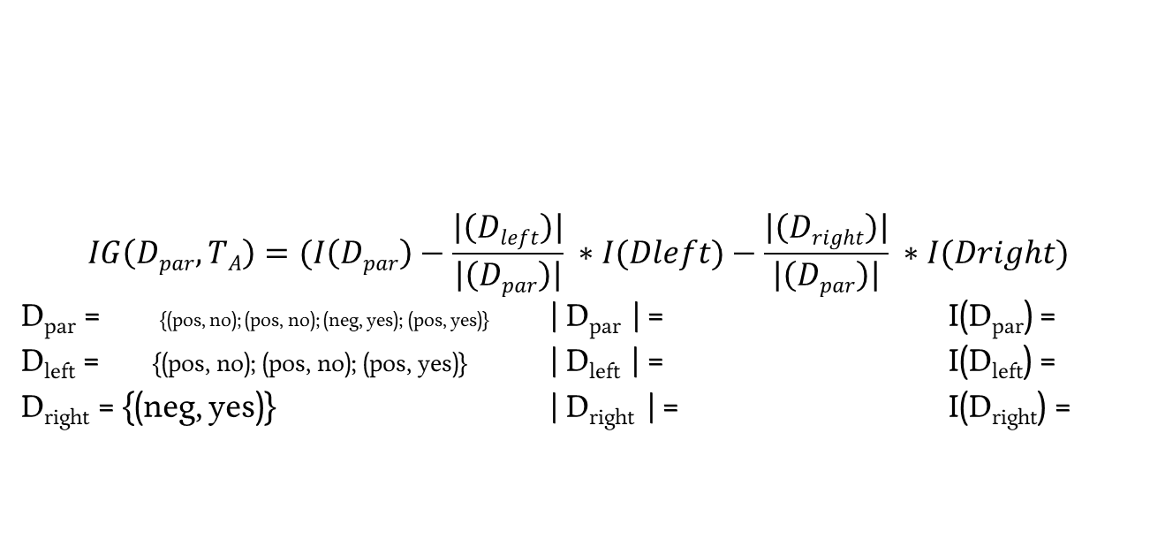

Decision Trees – Splitting Cancer
$$IG\left(Dpar,TA\right)=(I\left(Dpar\right)−\frac{\left|\left(Dleft\right)\right|}{\left|\left(Dpar\right)\right|} ∗I(Dleft)−\frac{\left|\left(Dright\right)\right|}{\left|\left(Dpar\right)\right|} ∗I(Dright)$$
D_{par} = {(pos, no); (pos, no); (neg, yes); (pos, yes)} | D_{par} | = I(D_{par}) =
D_{left} = {(pos, no); (pos, no); (pos, yes)} | D_{left} | = I(D_{left}) =
D_{right} = {(neg, yes)} | D_{right} | = I(D_{right}) =
Test A | Test B | Test C | Cancer?
Pos | Neg | Neg | No
Pos | Pos | Neg | No
Neg | Pos | Pos | Yes
Pos | Neg | Pos | Yes

Slide 11

Decision Trees – Splitting Cancer
$$IG\left(Dpar,TA\right)=(I\left(Dpar\right)−\frac{\left|\left(Dleft\right)\right|}{\left|\left(Dpar\right)\right|} ∗I(Dleft)−\frac{\left|\left(Dright\right)\right|}{\left|\left(Dpar\right)\right|} ∗I(Dright)$$
| D_{par} | =
| D_{left} | =
| D_{right} | =
Test A | Test B | Test C | Cancer?
Pos | Neg | Neg | No
Pos | Pos | Neg | No
Neg | Pos | Pos | Yes
Pos | Neg | Pos | Yes

Slide 12
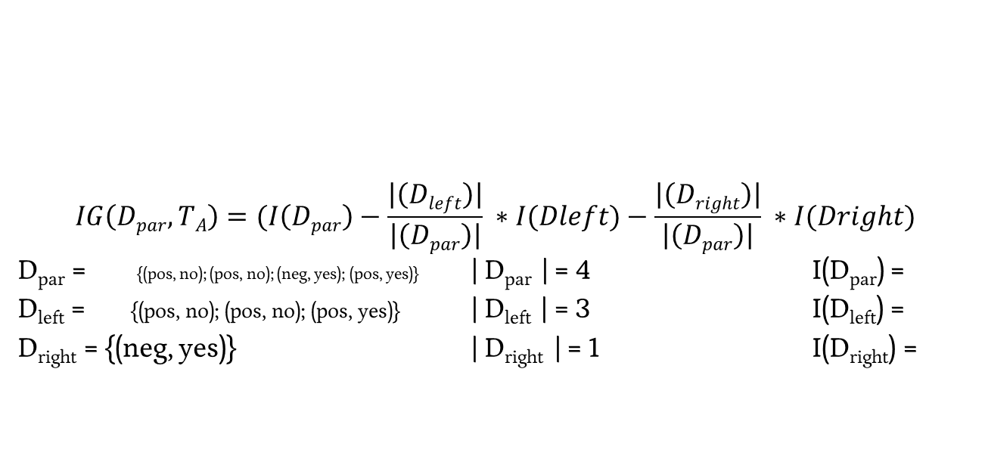
Decision Trees – Splitting Cancer
$$IG\left(Dpar,TA\right)=(I\left(Dpar\right)−\frac{\left|\left(Dleft\right)\right|}{\left|\left(Dpar\right)\right|} ∗I(Dleft)−\frac{\left|\left(Dright\right)\right|}{\left|\left(Dpar\right)\right|} ∗I(Dright)$$
D_{par} = {(pos, no); (pos, no); (neg, yes); (pos, yes)} | D_{par} | = 4 I(D_{par}) =
D_{left} = {(pos, no); (pos, no); (pos, yes)} | D_{left} | = 3 I(D_{left}) =
D_{right} = {(neg, yes)} | D_{right} | = 1 I(D_{right}) =
Test A | Test B | Test C | Cancer?
Pos | Neg | Neg | No
Pos | Pos | Neg | No
Neg | Pos | Pos | Yes
Pos | Neg | Pos | Yes

Slide 13

Decision Trees – Splitting Cancer
$$IG\left(Dpar,TA\right)=(I\left(Dpar\right)−\frac{\left|\left(Dleft\right)\right|}{\left|\left(Dpar\right)\right|} ∗I(Dleft)−\frac{\left|\left(Dright\right)\right|}{\left|\left(Dpar\right)\right|} ∗I(Dright)$$
I(D_{par}) =
I(D_{left}) =
I(D_{right}) =
Test A | Test B | Test C | Cancer?
Pos | Neg | Neg | No
Pos | Pos | Neg | No
Neg | Pos | Pos | Yes
Pos | Neg | Pos | Yes

Slide 14

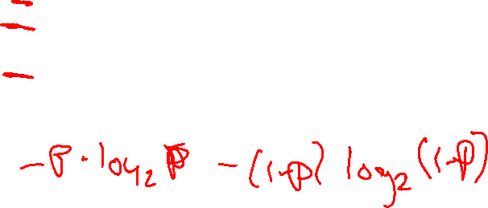
Decision Trees – Splitting Cancer
$$IG\left(Dpar,TA\right)=(I\left(Dpar\right)−\frac{\left|\left(Dleft\right)\right|}{\left|\left(Dpar\right)\right|} ∗I(Dleft)−\frac{\left|\left(Dright\right)\right|}{\left|\left(Dpar\right)\right|} ∗I(Dright)$$
I(D_{left}) =
Test A | Test B | Test C | Cancer?
Pos | Neg | Neg | No
Pos | Pos | Neg | No
Neg | Pos | Pos | Yes
Pos | Neg | Pos | Yes

Slide 15


Decision Trees – Splitting Cancer
$$IG\left(Dpar,TA\right)=(I\left(Dpar\right)−\frac{\left|\left(Dleft\right)\right|}{\left|\left(Dpar\right)\right|} ∗I(Dleft)−\frac{\left|\left(Dright\right)\right|}{\left|\left(Dpar\right)\right|} ∗I(Dright)$$
I(D_{right}) =
Test A | Test B | Test C | Cancer?
Pos | Neg | Neg | No
Pos | Pos | Neg | No
Neg | Pos | Pos | Yes
Pos | Neg | Pos | Yes

Slide 16
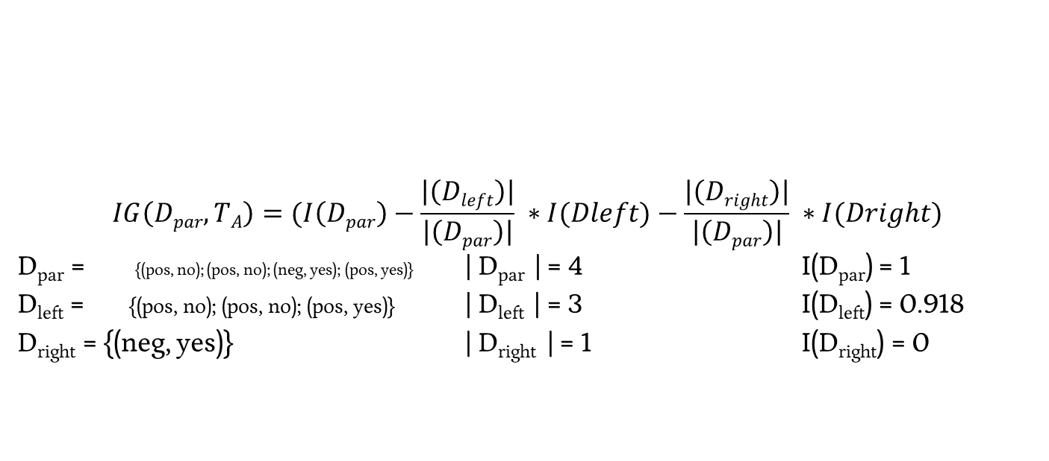
Decision Trees – Splitting Cancer
$$IG\left(Dpar,TA\right)=(I\left(Dpar\right)−\frac{\left|\left(Dleft\right)\right|}{\left|\left(Dpar\right)\right|} ∗I(Dleft)−\frac{\left|\left(Dright\right)\right|}{\left|\left(Dpar\right)\right|} ∗I(Dright)$$
D_{par} = {(pos, no); (pos, no); (neg, yes); (pos, yes)} | D_{par} | = 4 I(D_{par}) = 1
D_{left} = {(pos, no); (pos, no); (pos, yes)} | D_{left} | = 3 I(D_{left}) = 0.918
D_{right} = {(neg, yes)} | D_{right} | = 1 I(D_{right}) = 0
Test A | Test B | Test C | Cancer?
Pos | Neg | Neg | No
Pos | Pos | Neg | No
Neg | Pos | Pos | Yes
Pos | Neg | Pos | Yes

Slide 17

Decision Trees – Splitting Cancer
$$IG\left(Dpar,TA\right)=(1−\frac{3}{4} ∗0.918−\frac{1}{4} ∗0)$$
D_{par} = {(pos, no); (pos, no); (neg, yes); (pos, yes)} | D_{par} | = 4 I(D_{par}) = 1
D_{left} = {(pos, no); (pos, no); (pos, yes)} | D_{left} | = 3 I(D_{left}) = 0.918
D_{right} = {(neg, yes)} | D_{right} | = 1 I(D_{right}) = 0
Test A | Test B | Test C | Cancer?
Pos | Neg | Neg | No
Pos | Pos | Neg | No
Neg | Pos | Pos | Yes
Pos | Neg | Pos | Yes

Slide 18

Decision Trees – Splitting Cancer
$$IG\left(Dpar,TA\right)=0.3112$$
D_{par} = {(pos, no); (pos, no); (neg, yes); (pos, yes)} | D_{par} | = 4 I(D_{par}) = 1
D_{left} = {(pos, no); (pos, no); (pos, yes)} | D_{left} | = 3 I(D_{left}) = 0.918
D_{right} = {(neg, yes)} | D_{right} | = 1 I(D_{right}) = 0
Test A | Test B | Test C | Cancer?
Pos | Neg | Neg | No
Pos | Pos | Neg | No
Neg | Pos | Pos | Yes
Pos | Neg | Pos | Yes

Slide 19

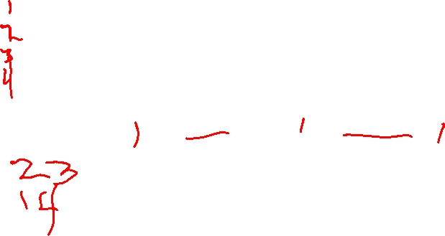
Decision Trees – Splitting Cancer
$$IG\left(Dpar,TB\right)=(I\left(Dpar\right)−\frac{\left|\left(Dleft\right)\right|}{\left|\left(Dpar\right)\right|} ∗I(Dleft)−\frac{\left|\left(Dright\right)\right|}{\left|\left(Dpar\right)\right|} ∗I(Dright)$$
D_{par} = | D_{par} | = I(D_{par}) =
D_{left} = | D_{left} | = I(D_{left}) =
D_{right} = | D_{right} | = I(D_{right}) =
Test A | Test B | Test C | Cancer?
Pos | Neg | Neg | No
Pos | Pos | Neg | No
Neg | Pos | Pos | Yes
Pos | Neg | Pos | Yes

Slide 20

Decision Trees – Splitting Cancer
$$IG\left(Dpar,TB\right)=0$$
D_{par} = {(neg, no); (pos, no); (pos, yes); (neg, yes)} | D_{par} | = 4 I(D_{par}) = 1
D_{left} = {(pos, no); (pos, yes)} | D_{left} | = 2 I(D_{left}) = 1
D_{right} = {(neg, no); (neg, yes)} | D_{right} | = 2 I(D_{right}) = 1
Test A | Test B | Test C | Cancer?
Pos | Neg | Neg | No
Pos | Pos | Neg | No
Neg | Pos | Pos | Yes
Pos | Neg | Pos | Yes

Slide 21

Decision Trees – Splitting Cancer
$$IG\left(Dpar,TC\right)=(I\left(Dpar\right)−\frac{\left|\left(Dleft\right)\right|}{\left|\left(Dpar\right)\right|} ∗I(Dleft)−\frac{\left|\left(Dright\right)\right|}{\left|\left(Dpar\right)\right|} ∗I(Dright)$$
D_{par} = | D_{par} | = I(D_{par}) =
D_{left} = | D_{left} | = I(D_{left}) =
D_{right} = | D_{right} | = I(D_{right}) =
Test A | Test B | Test C | Cancer?
Pos | Neg | Neg | No
Pos | Pos | Neg | No
Neg | Pos | Pos | Yes
Pos | Neg | Pos | Yes

Slide 22

Decision Trees – Splitting Cancer
$$IG\left(Dpar,TC\right)=1$$
D_{par} = {(neg, no); (neg, no); (pos, yes); (pos, yes)} | D_{par} | = 4 I(D_{par}) = 1
D_{left} = {(pos, yes); (pos, yes)} | D_{left} | = 2 I(D_{left}) = 0
D_{right} = {(neg, no); (neg, no)} | D_{right} | = 2 I(D_{right}) = 0
Test A | Test B | Test C | Cancer?
Pos | Neg | Neg | No
Pos | Pos | Neg | No
Neg | Pos | Pos | Yes
Pos | Neg | Pos | Yes

Slide 23
Decision Trees – Measures of Impurity
We used Entropy as the measure of impurity / messiness / chaos
Is this the only option? The correct option?

Slide 24
Decision Trees – Measures of Impurity
We used Entropy as the measure of impurity / messiness / chaos
Is this the only option? The correct option?
Misclassification Error = min(p, 1-p)

Slide 25
Decision Trees – Measures of Impurity
We used Entropy as the measure of impurity / messiness / chaos
Is this the only option? The correct option?
Gini Index: 1 - ∑_{c=1…n} p_{c}²
Binary case: 1 – p² – (1 – p)² = 2p(p-1)

Slide 26
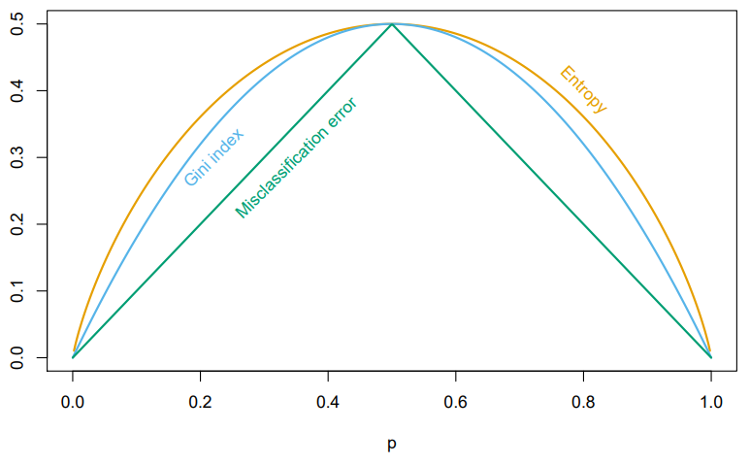
Decision Trees – Measures of Impurity
We used Entropy as the measure of impurity / messiness / chaos
Is this the only option? The correct option?
Considerations: Differentiability, Computational Speed
Different implementations (CART, C4.5) use different functions

Slide 27
Decision Trees – Adding Complexity
How do we decide the order of our splits?
How do we decide the location of splits?
With continuous variables?
How do we know we’re done?

Slide 28
Decision Trees – Continuous Variables
Eyeball – What’s our best splitting point here for Test C?
Test A | Test B | Test C | Cancer?
Pos | Neg | 3 | No
Pos | Pos | 2 | No
Neg | Pos | 6 | Yes
Pos | Neg | 5 | Yes

Slide 29
Decision Trees – Continuous Variables
Eyeball – What’s our best splitting point here for Test C?
How did you do make this decision?
Test A | Test B | Test C | Cancer?
Pos | Neg | 3 | No
Pos | Pos | 2 | No
Neg | Pos | 6 | Yes
Pos | Neg | 5 | Yes

Slide 30
Decision Trees – Continuous Variables
Eyeball – What’s our best splitting point here?
Test A | Test B | Test C | Cancer?
7 | 4 | 3 | No
9 | 8 | 2 | No
2 | 6 | 6 | Yes
8 | 3 | 5 | Yes

Slide 31
Decision Trees – Continuous Variables
Eyeball – What’s our best splitting point here?
Try all options for all variables
IG(D_{par}, x_{i,j})
Test A | Test B | Test C | Cancer?
7 | 4 | 3 | No
9 | 8 | 2 | No
2 | 6 | 6 | Yes
8 | 3 | 5 | Yes

Slide 32
Decision Trees – Continuous Variables
Eyeball – What’s our best splitting point here?
Try all options for all variables
IG(D_{par}, x_{i,j})
Sort first, then compute in one pass
Test A | Test B | Test C | Cancer?
7 | 4 | 3 | No
9 | 8 | 2 | No
2 | 6 | 6 | Yes
8 | 3 | 5 | Yes

Slide 33
Decision Trees – Adding Complexity
How do we decide the order of our splits?
How do we decide the location of splits?
With continuous variables?
How do we know we’re done?

Slide 34
Decision Trees – Stopping Point
Creating Leaves

Slide 35
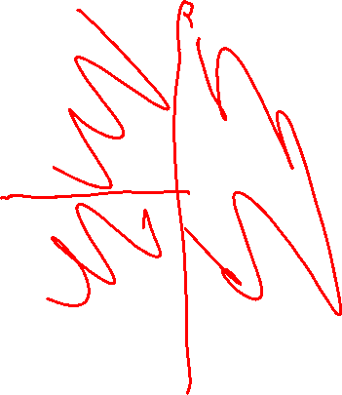
Decision Trees – Stopping Point
Creating Leaves
When we reach 0 entropy

Slide 36
Decision Trees – Stopping Point
Creating Leaves
When we reach 0 entropy

Slide 37
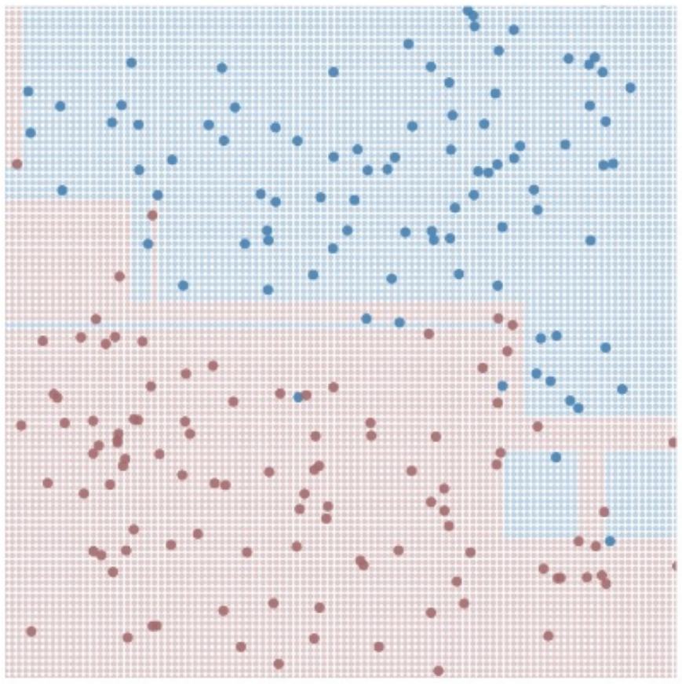
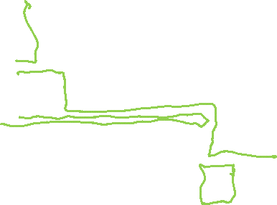
Decision Trees – Stopping Point
Large, Complex Trees

Slide 38

Decision Trees – Stopping Point
Large, Complex Trees
# dimensions spirals out of control
Prone to high variance
Overfitting

Slide 39
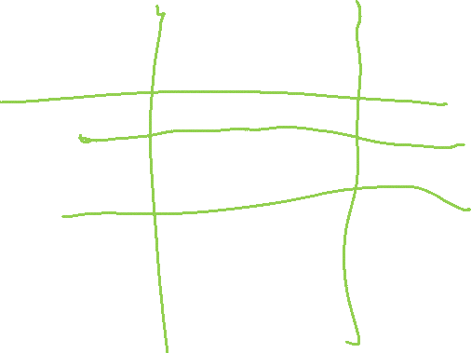
Decision Trees – Stopping Point
Large, Complex Trees
# dimensions spirals out of control
Prone to high variance
Overfitting
What do you want to do about it?

Slide 40
Decision Trees – Limiting Complexity
Set a maximum depth for your tree

Slide 41
Decision Trees – Limiting Complexity
Set a maximum depth for your tree
Set a maximum number of leaves for your tree (proxy on depth, but allows for deep and shallow branches)

Slide 42
Decision Trees – Limiting Complexity
Set a maximum depth for your tree
Set a maximum number of leaves for your tree (proxy on depth, but allows for deep and shallow branches)
Penalize larger trees (more leaves)

Slide 43

Decision Trees – Pruning
Remove segments (subtrees from your tree)
Notes:
https://yourwaytreeserviceinc.com/wp-content/uploads/2014/04/tree-trimming-san-fernando-valley.jpg

Slide 44
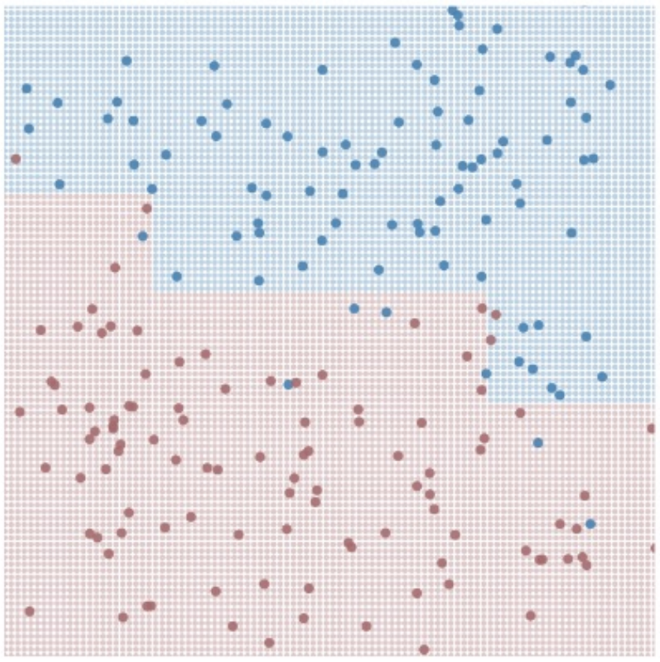
Decision Trees – Pruning
Remove segments (subtrees from your tree)
→

Slide 45
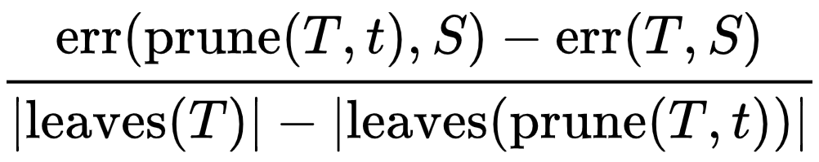
Decision Trees – Limiting Complexity
Penalize larger trees (more leaves)
https://en.wikipedia.org/wiki/Decision_tree_pruning

Slide 46
Ensemble Methods, Boosting, Bagging, & Random Forests

Slide 47

Intuition
Let’s build a few “bad” models

Slide 48
Intuition
Let’s build a few “bad” models
Let’s then combine the predictions!

Slide 49
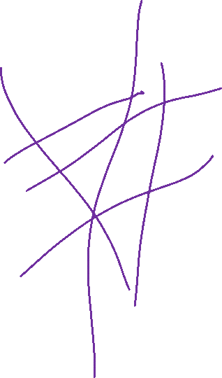
Intuition
Let’s build a few “bad” models
Let’s then combine the predictions!
Let’s add even more “bad” models!

Slide 50
Ensemble Methods
Build a bunch of dumb models on the training data
There are a bunch of ways to do this, stay tuned!
Feed our test data to all the models, get predictions
Take the best class from all of these models as our answer

Slide 51
Ensemble Learning – Dataset
X₁ | X₂ | X₃ | X₄ | X₅ | Y
Size (Sq. Ft.) | # Bed | # Bath | Year Built | Price ($) | Single Family?
1200 | 1 | 1.5 | 1998 | 200,000 | No
1800 | 2 | 2 | 1985 | 450,000 | Yes
800 | 1 | 1 | 2017 | 250,000 | No
2500 | 3 | 2 | 1975 | 500,000 | No
2800 | 4 | 2.5 | 1983 | 400,000 | Yes
… | … | … | … | …

Slide 52

Building “Dumb” Models – Step 1
Maybe 10% of the points in training
are causing errors with testing…

Slide 53
Building “Dumb” Models – Step 1
Maybe 10% of the points in training
are causing errors with testing…

Slide 54
Building “Dumb” Models – Step 1
Maybe 10% of the points in training
are causing errors with testing…
What happens if I build a tree based on
a resampling of my points?

Slide 55
Building “Dumb” Models – Resampling
Pick N’ (number in subsample) points
Train model on subsample

Slide 56
Building “Dumb” Models – Resampling
Pick N’ points
Train model on subsample

Slide 57
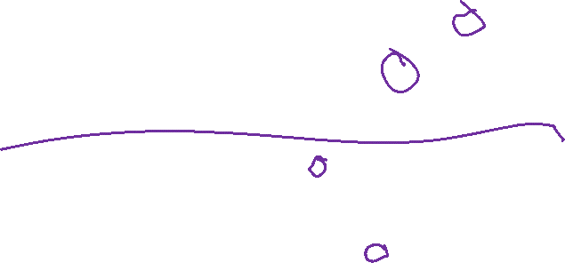
Building “Dumb” Models – Step 1
Maybe 10% of the points in training
are causing errors with testing…
What happens if I build a tree based on
10% of the points?

Slide 58
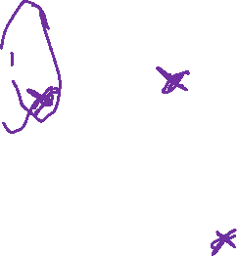
Building “Dumb” Models – Step 1
Maybe 10% of the points in training
are causing errors with testing…
What happens if I build a tree based on
10% of the points?
What happens if I build a tree based on
90% of the points?

Slide 59
Building “Dumb” Models – Resampling
Small Subsets
- Prone to high bias (underfitting)

Slide 60
Building “Dumb” Models – Resampling
Small Subsets
- Prone to high bias (underfitting)
Large Subsets
- Prone to behave exactly like our dataset

Slide 61
Building “Dumb” Models – Bootstrapping
Large Subsets with replacement
- We will oversample some points, neglect others

Slide 62
Building “Dumb” Models – Bootstrapping
Large Subsets with replacement
- We will oversample some points, neglect others
Sampling N’ = N
- Expected 1 – 1/e (approx. 63.2%) coverage
https://en.wikipedia.org/wiki/Bootstrap_aggregating

Slide 63
Building “Dumb” Models – Bootstrapping
Large Subsets with replacement
- We will oversample some points, neglect others
Sampling N’ = N
- Expected 1 – 1/e (approx. 63.2%) coverage
N is too large for my memory
- Reduce N’ – but realize the bias-variance tradeoff
https://en.wikipedia.org/wiki/Bootstrap_aggregating

Slide 64
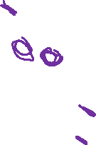
Building “Dumb” Models – Step 2
Maybe 10% of the points in training
are causing errors with testing…
What happens if I build a tree based on a resampling of the points?

Slide 65

Building “Dumb” Models – Step 2
Maybe 10% of the points in training
are causing errors with testing…
What happens if I build a tree based on a resampling of the points?
What happens if I build a bunch of trees based on a resampling of the points?

Slide 66

Building “Dumb” Models – Bagging (Bootstrap Aggregating)
TRAINING
For M (# Models) iterations:
Select N points with replacement
Train a decision tree
Hang on to that decision tree
TESTING
For each test point:
Ask all the decision trees what decision to make
Accept Y (the best answer)

Slide 67
Building “Dumb” Models – Bagging
TRAINING
For M iterations:
Select N points with replacement
Train a decision tree
Hang on to that decision tree
TESTING
For each test point:
Ask all the decision trees what decision to make
Accept Y

Slide 68
Ensemble Learning
Build a group of models H(x) = h₁(x), h₂(x), … h_{k}(x)

Slide 69
Building “Dumb” Models – Bagging
TRAINING
For K iterations:
Select N points with replacement
Train a decision tree
Hang on to that decision tree
TESTING
For each test point:
Ask all the decision trees what decision to make
Accept Y

Slide 70
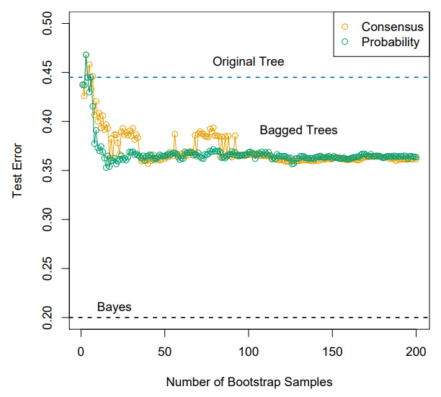

Bagging – Appropriate number of models
In short – it depends
- Think of this as a stopping parameter
- You’ll see numbers like 30, 50, 100 used a lot…

Slide 71

Bagging – Choosing Consensus
Binary decision from each tree
Take the majority decision

